Slide 1

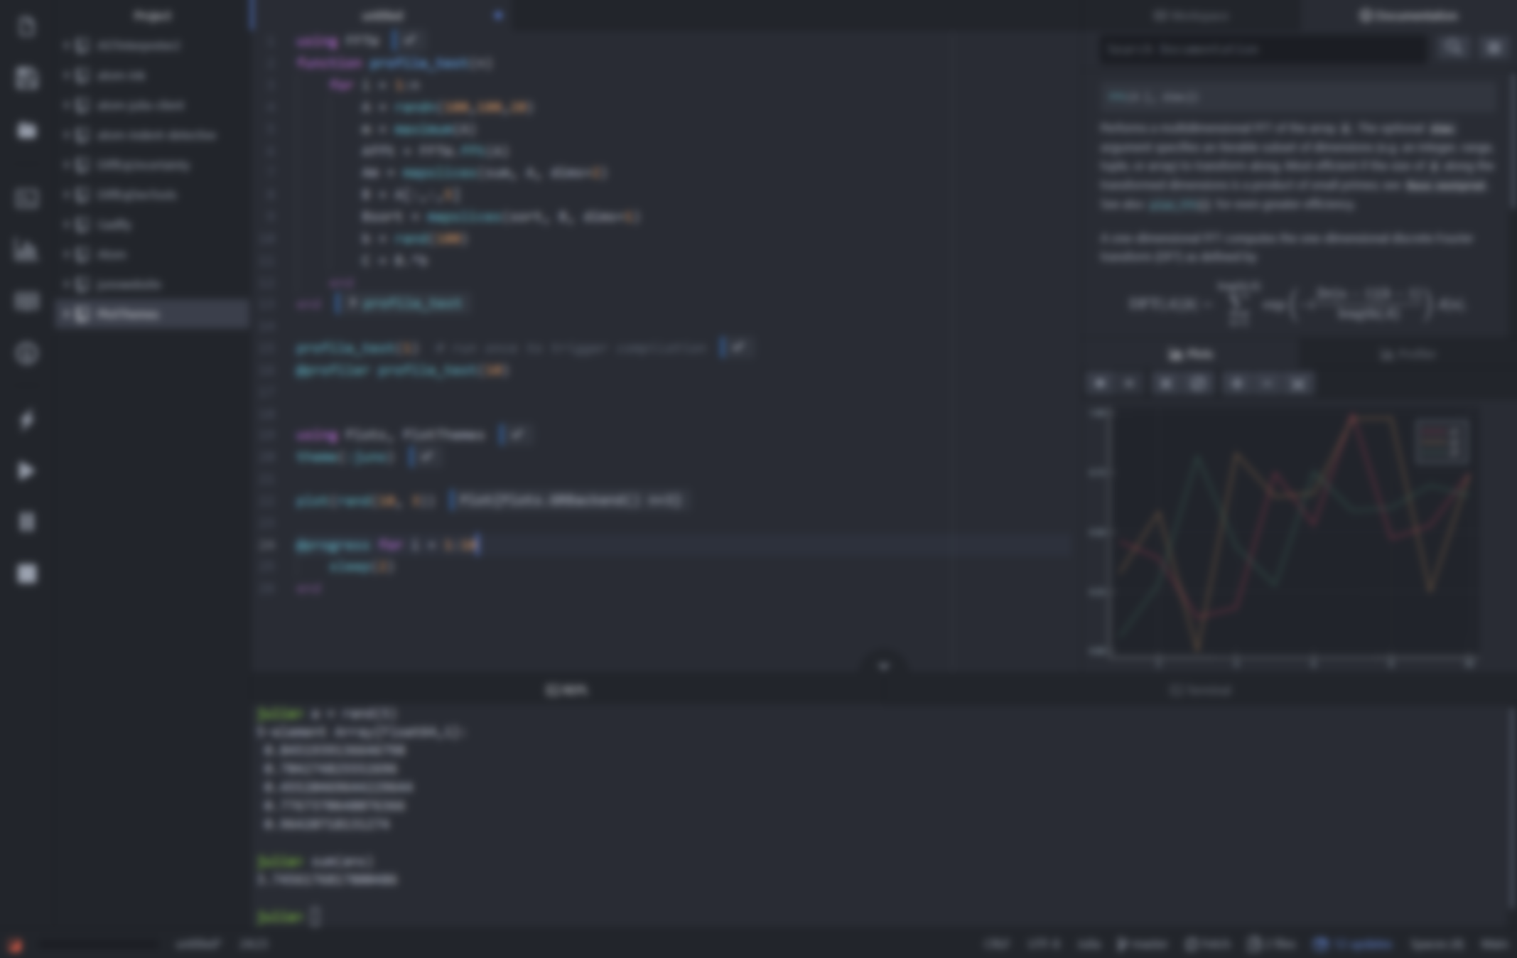



Julia Workshop
Carsten Bauer @ University of Oulu, Finnland, February 2020

Slide 2
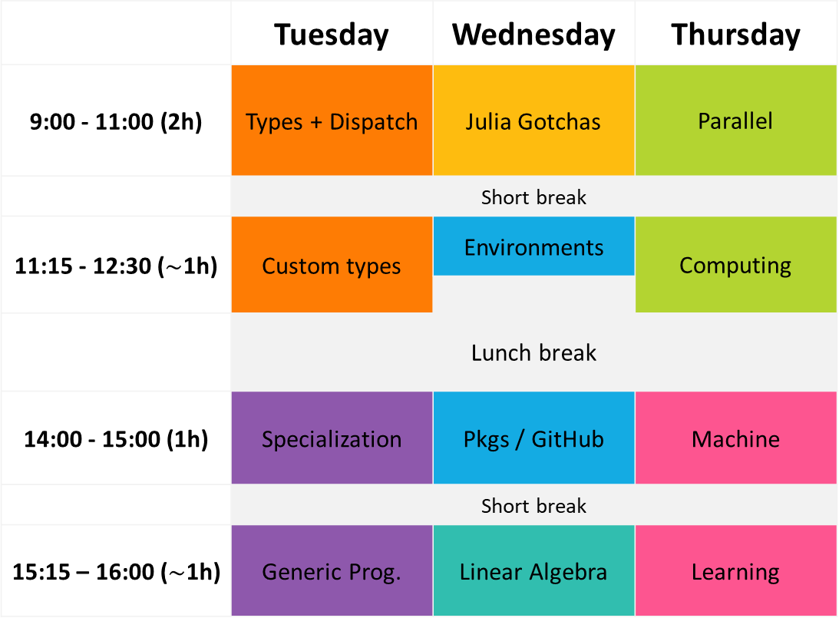
 | Tuesday | Wednesday | Thursday
9:00 - 11:00 (2h) | Types + Dispatch | Julia Gotchas | Parallel
 | Short break
11:15 - 12:30 ($\sim$1h) | Custom types | Environments | Computing
 | Lunch break
14:00 - 15:00 (1h) | Specialization | Pkgs / GitHub | Machine
 | Short break
15:15 – 16:00 ($\sim$1h) | Generic Prog. | Linear Algebra | Learning

Slide 3
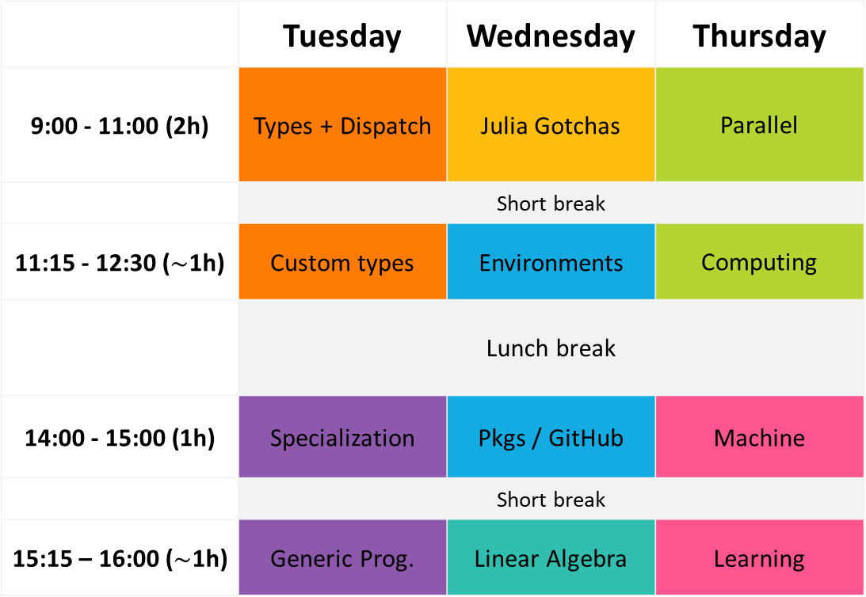
 | Tuesday | Wednesday | Thursday
9:00 - 11:00 (2h) | Types + Dispatch | Julia Gotchas | Parallel
 | Short break
11:15 - 12:30 ($\sim$1h) | Custom types | Environments | Computing
 | Lunch break
14:00 - 15:00 (1h) | Specialization | Pkgs / GitHub | Machine
 | Short break
15:15 – 16:00 ($\sim$1h) | Generic Prog. | Linear Algebra | Learning

Slide 4
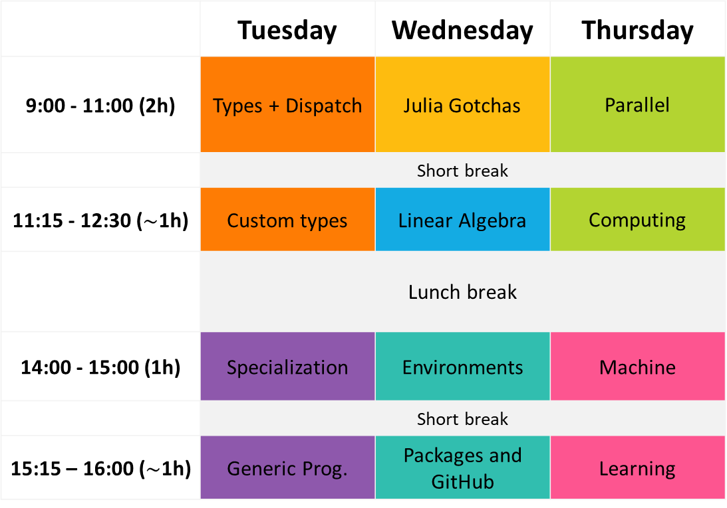
 | Tuesday | Wednesday | Thursday
9:00 - 11:00 (2h) | Types + Dispatch | Julia Gotchas | Parallel
 | Short break
11:15 - 12:30 ($\sim$1h) | Custom types | Linear Algebra | Computing
 | Lunch break
14:00 - 15:00 (1h) | Specialization | Environments | Machine
 | Short break
15:15 – 16:00 ($\sim$1h) | Generic Prog. | Packages and GitHub | Learning

Slide 5

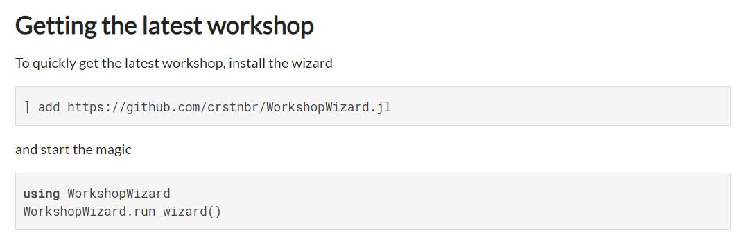
https://github.com/crstnbr/WorkshopWizard.jl

Slide 6
In a Terminal
git clone https://github.com/crstnbr/JuliaOulu20
cd JuliaOulu20
julia install.jl

Slide 7
Interactive part

Slide 8

Disclaimer
This workshop will be opinionated!
This workshop will be incomplete!
The topics will (likely) be too easy and too difficult!
There are other great languages out there!

Slide 9
The Power of Language

Slide 10
The Power of Language
for Performance

Slide 11
The Power of Language
for Productivity

Slide 12
The Power of Language
for Abstraction

Slide 13
The Power of Language
for Community Building

Slide 14
The Power of Language
for Code Reuse

Slide 15
The Power of Language
for Scientific Computing

Slide 16
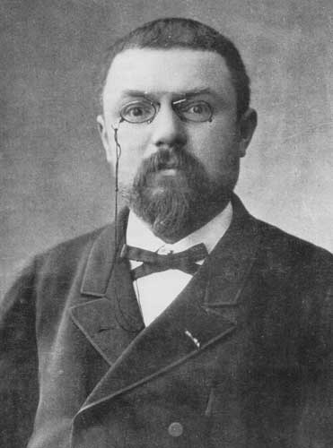
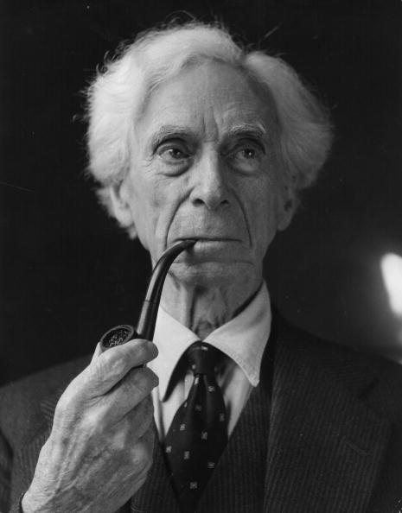
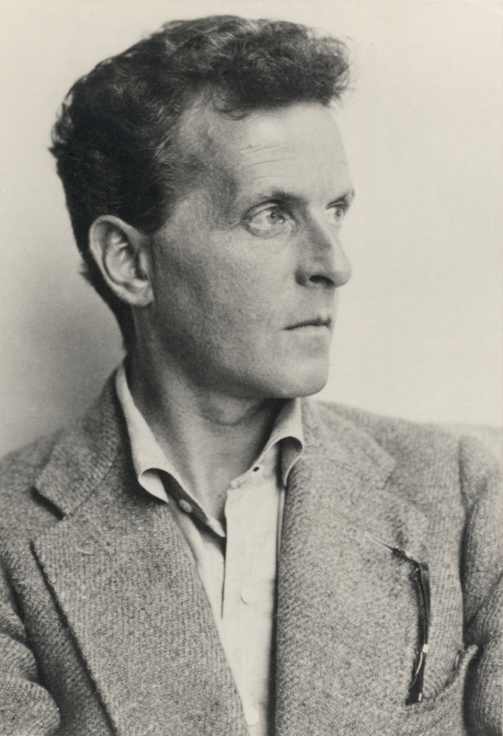
Historical precedent
When language has been well chosen, one is astonished… (in mathematics what’s possible…)
Henri Poincaré
Language serves not only to express thoughts, but to make possible thoughts which could not exist without it.
Bertrand Russell
The limits of my language mean the limits of my world.
Ludwig Wittgenstein

Slide 17


What does science need from a programming language?
Performance
Workflow: roll up sleeves & performance engineer

Slide 18
What does science need from a programming language?
Easy to write and read
Fast and scalable
Interactive

Slide 19








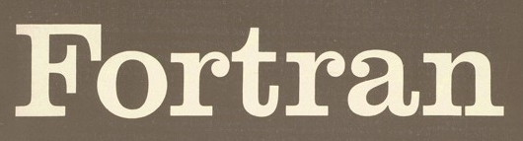
There’s a plethora of programming languages

Slide 20
There’s a plethora of programming languages

Slide 21
There’s a plethora of programming languages
Slow(ish)
Fast

Slide 22
There’s a plethora of programming languages
Compiled
Interpreted

Slide 23
There’s a plethora of programming languages
Static
Dynamic

Slide 24
There’s a plethora of programming languages
Speed
Convenience

Slide 25
The “two language problem”
a.k.a Ousterhout's dichotomy
Prototype
Production

Slide 26
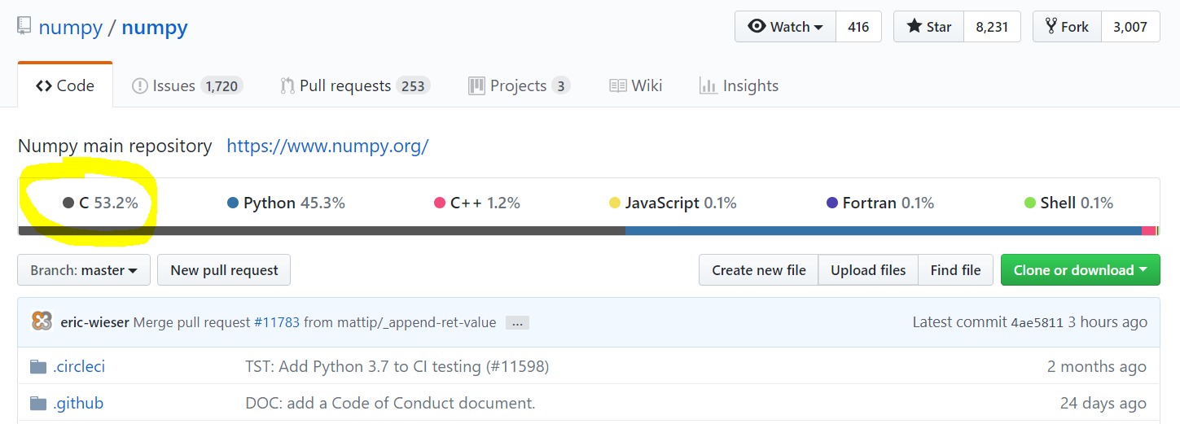
The “two language problem”

Slide 27

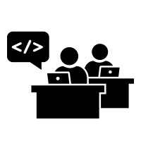

The “two language problem”
User
Developer

Slide 28
The “two language problem”
static
dynamic
compiled
interpreted
user types
standard types
standalone
glue

Slide 29

dynamic
compiled
user types
and
standard types
standalone
or
glue

Slide 30
What do we want from a PL?
The unification
Simple yntax + grammar
Expressive
Fast
Interactive

Slide 31
What do we want from a PL?
The unification
function babylonian(α; N = 10)
@assert α > 0 "α must be > 0"
t = (1+α)/2
for i = 2:N
t = (t + α/t)/2
end
t
end
babylonian(π) ≈ √π
Expressive
Fast
Interactive
“Feels like Python, runs like C”

Slide 32
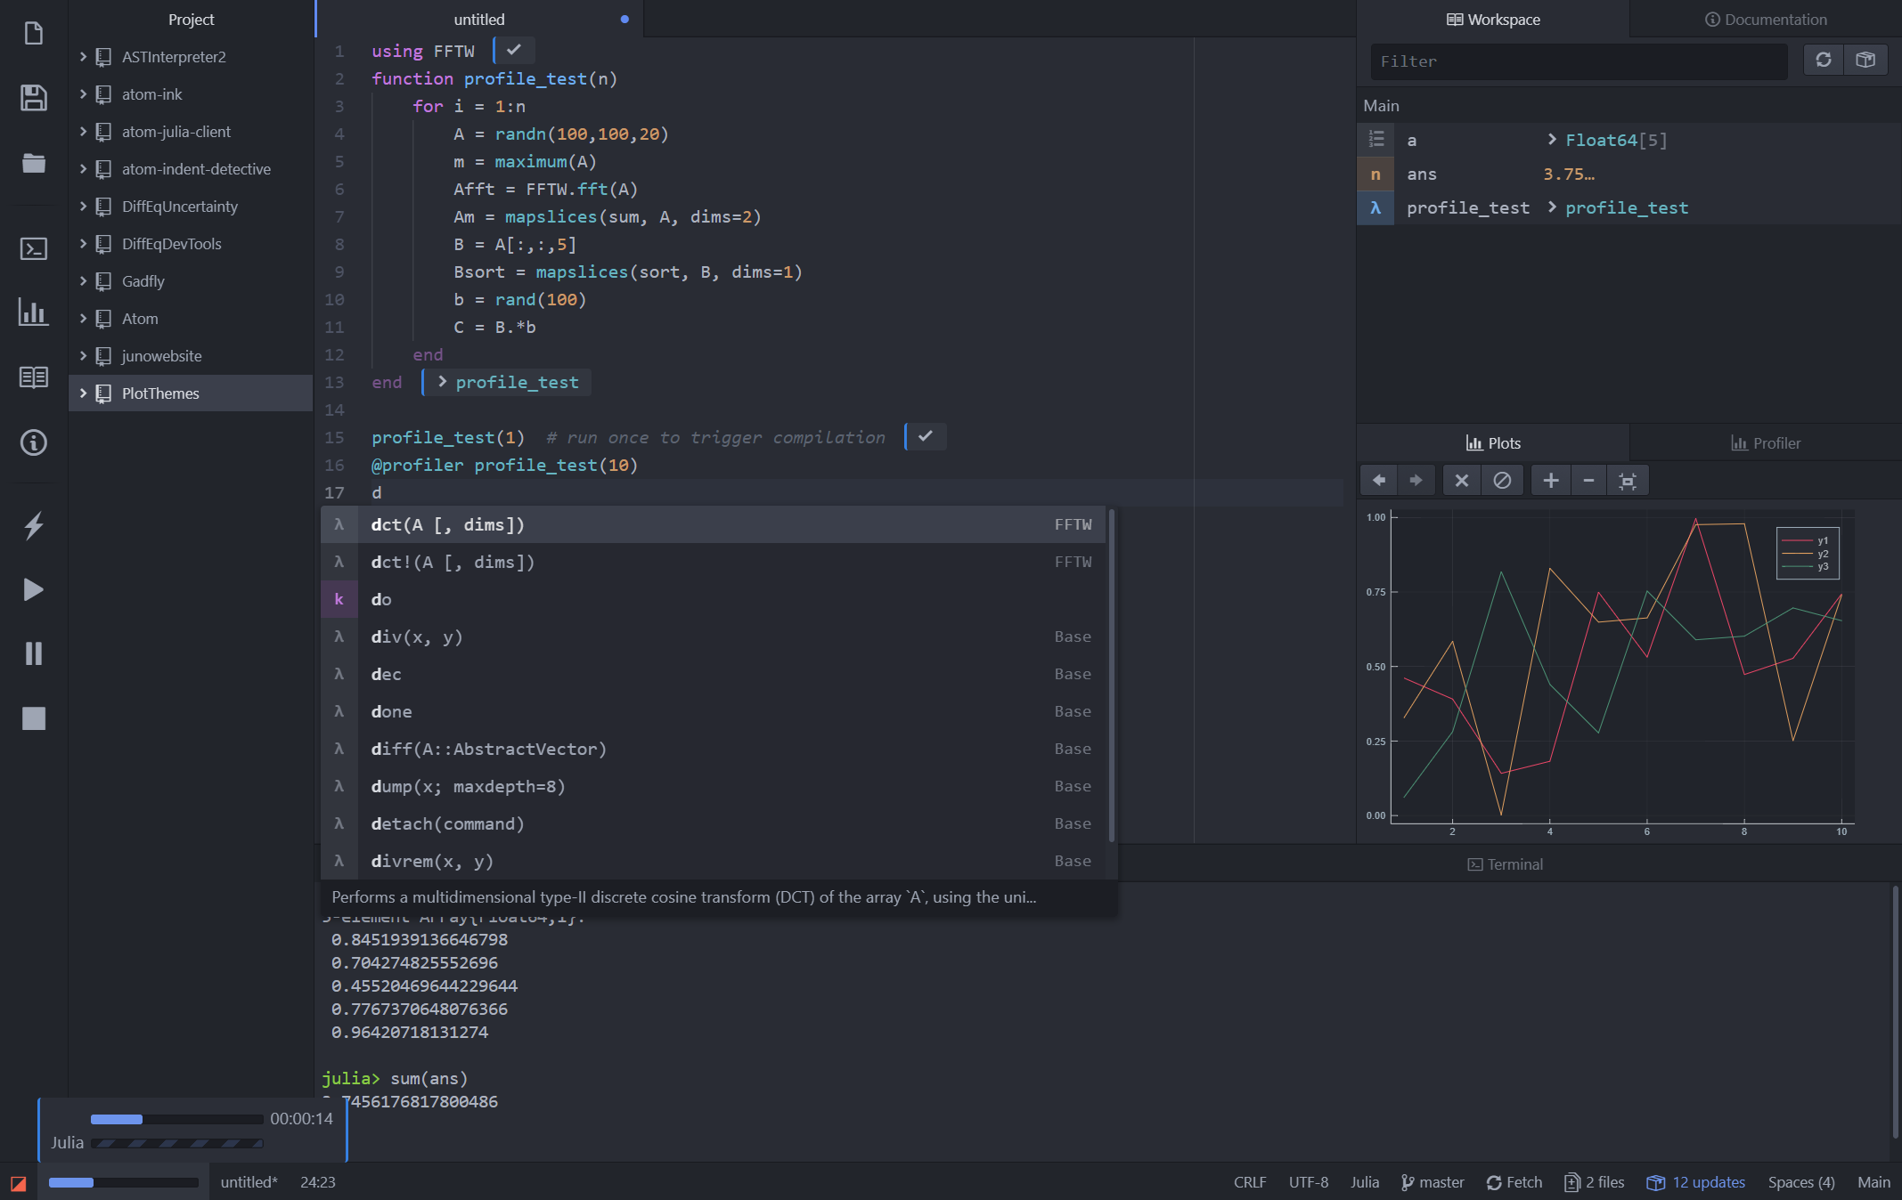
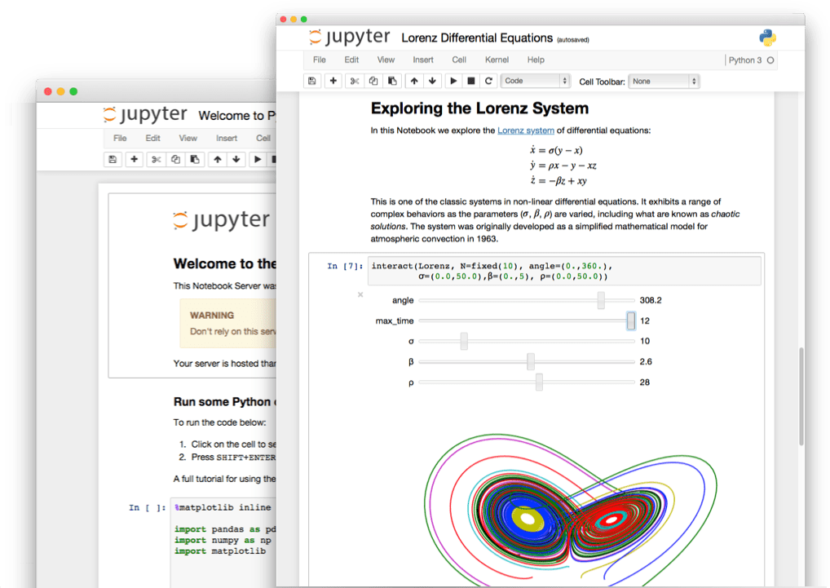
What do we want from a PL?
The unification
Simple yntax + grammar
Expressive
Fast
Interactive
“Feels like Python, runs like C”

Slide 33
What do we want from a PL?
The unification
julia> function sumup()
x = 0
for i in 1:100
x += i
end
x
end
sumup (generic function with 2 methods)
julia> @code_llvm debuginfo=:none sumup()
; Function Attrs: uwtable
define i64 @julia_sumup_12626() #0 {
top:
ret i64 5050
}
Simple yntax + grammar
Expressive
Fast
Interactive
Just returns the answer!
(The for loop was compiled away)
“Feels like Python, runs like C”

Slide 34

Python
Matlab
Runtime
Julia
C++
C
Fortran
Code complexity

Slide 35
Expressive & fast
Python
Matlab
Julia
Fortran
Runtime
C
C++
Code complexity

Slide 36
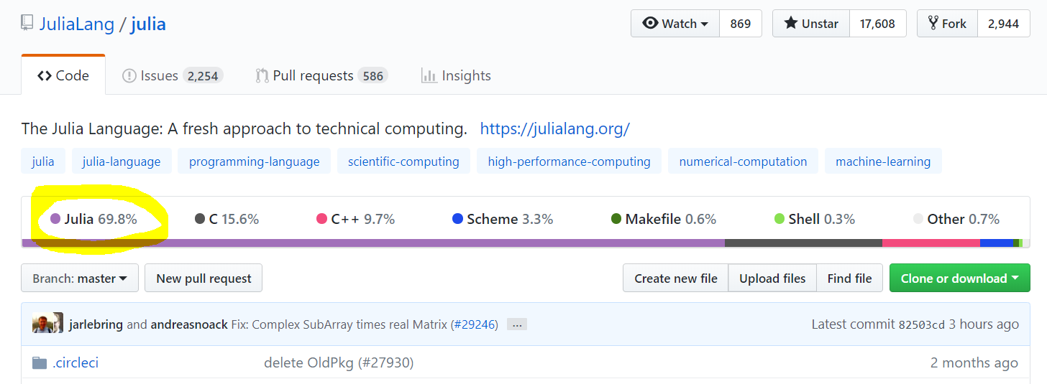
Free and open source

Slide 37

Inviting
User
Developer

Slide 38
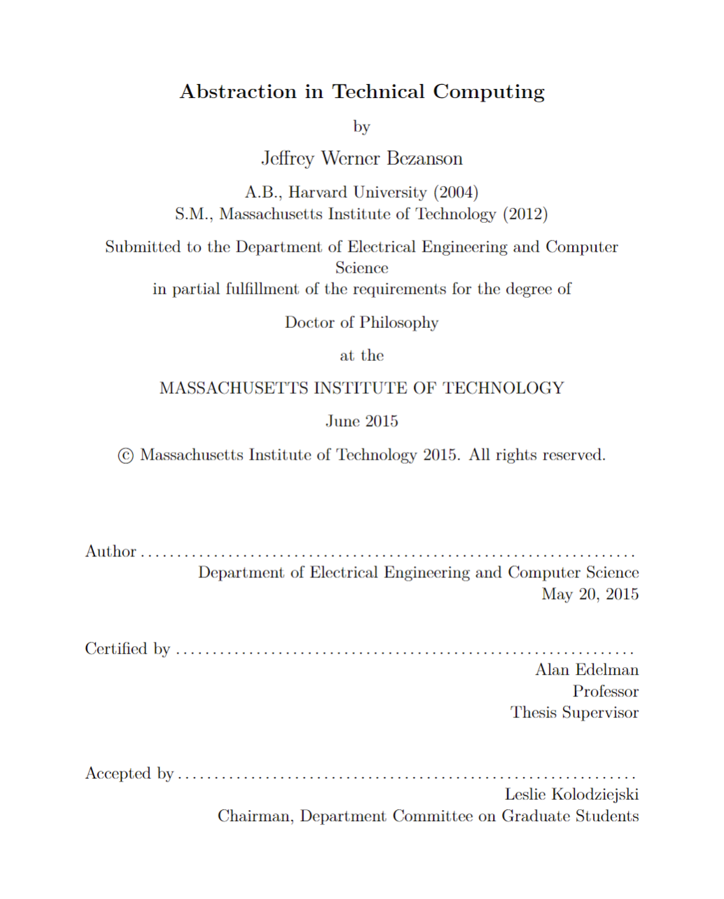
How old is Julia?
2009 Jeff, Stefan, Viral, and Alan start working on Julia
2012 Blog post: Why we created Julia
2015 Jeff’s PhD & JuliaComputing
2018 Julia 1.0
Founders talk @ JuliaCon 2018: https://www.youtube.com/watch?v=1jN5wKvN-Uk

Slide 39

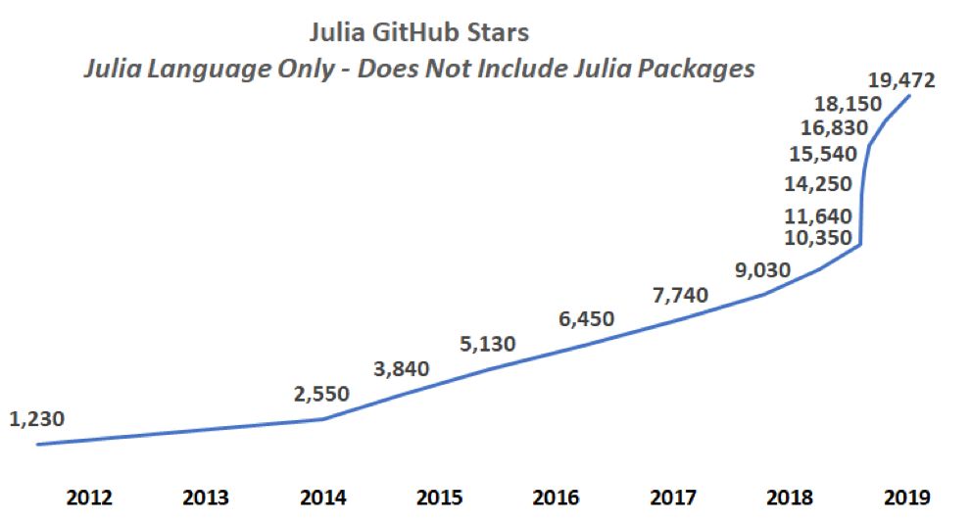
Julia stars
* Base language, does not include packages
https://juliacomputing.com/blog/2019/01/04/january-newsletter.html

Slide 40
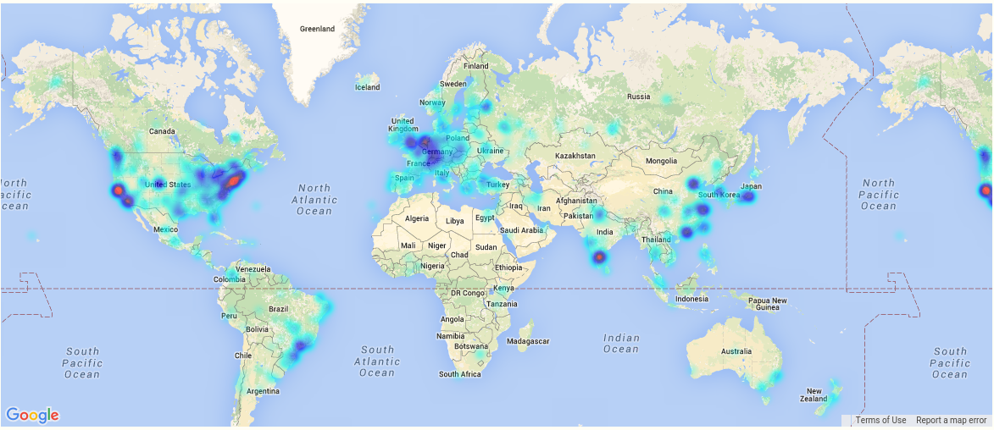
A global community
More than 12 Million downloads, >3000 packages

Slide 41
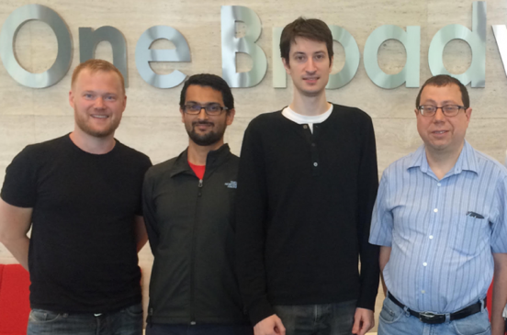
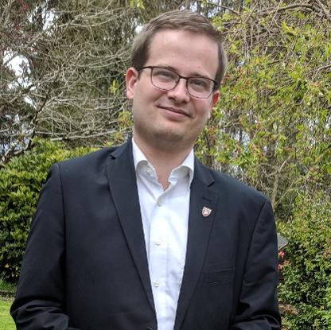
James H. Wilkinson Prize
For Numerical Software
Forbes
30 under 30
IEEE Babbage Prize
IEEE Fellow
Stefan Karpinski
Viral B. Shah
Jeff Bezanson
(2019)
Keno Fischer
(2019)
Prof. Alan Edelman
(2018)

Slide 42































Notes:
Universities teaching Julia

Slide 43
Let’s get started!

